Slide 1


Graiguenamangh/Tinnahinch
FLOOD RELIEF SCHEME
UPDATE – JANUARY 2020
Emir Slattery, Project Manager, Kilkenny County Council.

Slide 2
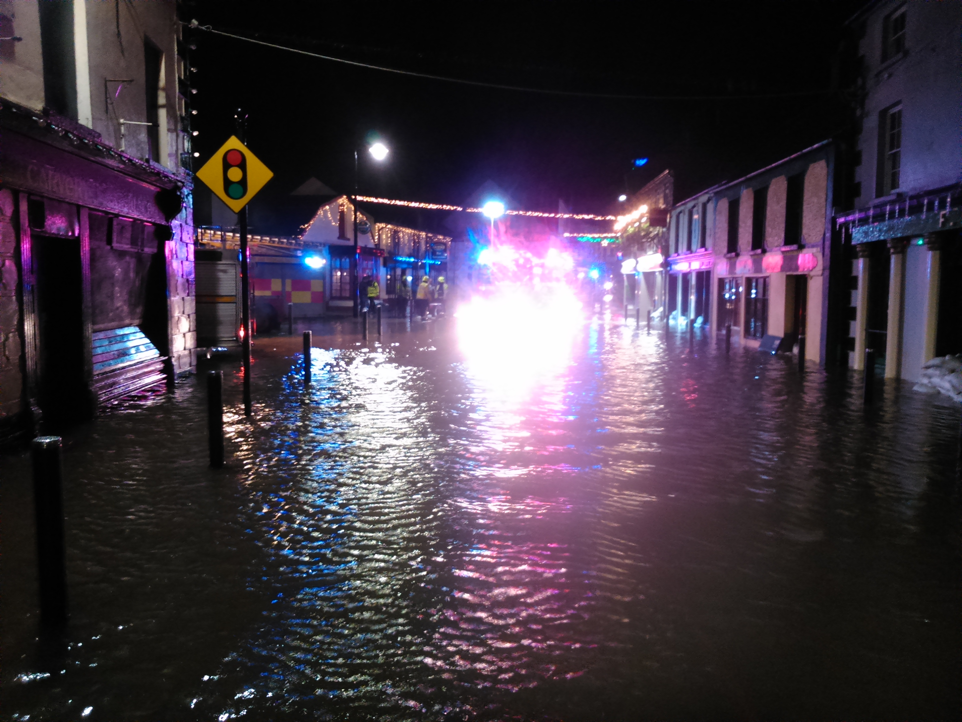
Storm Frank – December 2015/January 2016

Slide 3
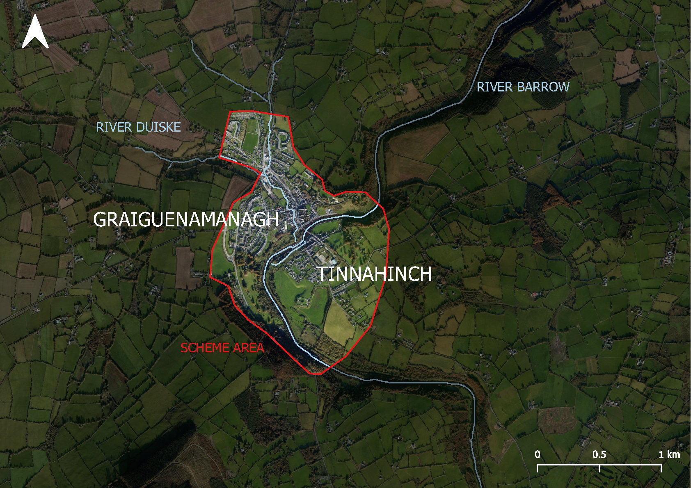
Scheme
Area
T
Funding was approved by the OPW for Flood Relief Scheme in 2018 – 9.06 million euros was allocated.
The Study Area
Aligned with CFRAM’s
River Barrow, River Duiske and any tributaries
The study will include any areas that require hydrological or environmental assessment as part of the scheme.

Slide 4
TimeFrame for Project
Completed By:
Stage 1 Scheme Development and Preliminary Design Q4 2021
Stage 2 Planning and Public Exhibition Q3 2022
Stage 3 Detailed Design, Confirmation and Tender Q1 2023
Stage 4 Construction Supervision Q1 2025
Stage 5 Handover of Works Q2 2026

Slide 5
Progress to Date on Stage 1:
Kilkenny County Council appointed Byrne Looby & Partners as Consultations to develop and implement a Flood Relief Scheme in March 2020
Project Website went live in June 2020
Public Consultation – Online due to Covid 19 restrictions July 2020
Newsletter Drop – October 2020
Topographical Survey completed in November 2020
Environmental Baseline Surveys are on-going in the Scheme Area.
Hydrology & Hydraulic Design of both the Barrow and Duiske Rivers is on-going
Stage 1 Completion date is the end of 2021

Slide 6
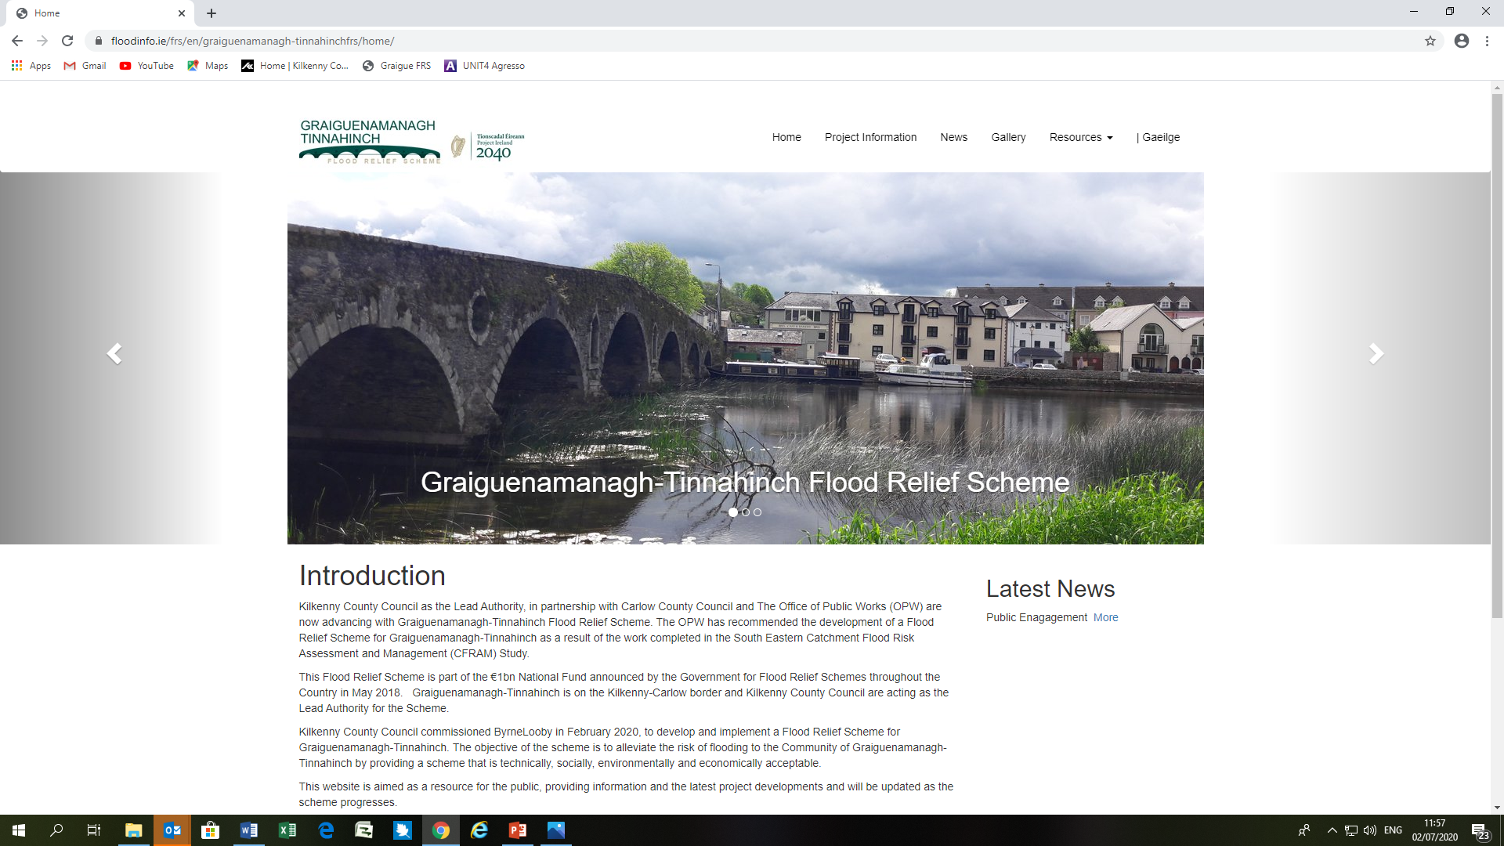
Project Website went live – Friday 26th June 2020
www.floodinfo.ie/frs/en/graiguenamanagh-tinnahinchfrs
It is aimed as a resource for the public, providing information and the latest project developments and will be updated as the scheme progresses.

Slide 7
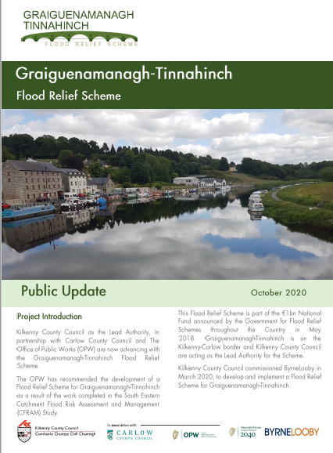
Newsletter Drop
All residents & premises in Graiguenamangh/Tinnahinch in Oct 2020
Purpose of the Newsletter is to inform the public of the scheme and progress to date
Provided Contact details for the Project Team
Submissions/Comments Welcome

Slide 8
Contact Details
Email : GTFRS@Byrnelooby.com
Or
Emir.slatttery@kilkennycoco.ie

